Slide 1
Geospatial data visualisation using R
Andy Baker

Slide 2
This session
The main aim of this session:
Introduce you to what is available on the geospatial-vis-templates GitHub repository.
Agenda:
Why did I make this repo?
What map templates are available?
Example: Hexagon-based cartogram of LADs in England
Helpful tools:
Converting postcodes to points and areas
Converting from one area to another
Creating a lookup table between two geographies
Automatic quintile legend
Other useful info:
Which is best? Shapefile or GeoJSON?
Teams channel
mapshaper.org
Slide 2

Slide 3
Why did I make this repo?
Regular asks for geospatial analyses
Geospatial data is notoriously fiddly and coding is hard
Default map plots are ugly and boring
This repo should save us all time dealing with geospatial data

Slide 4
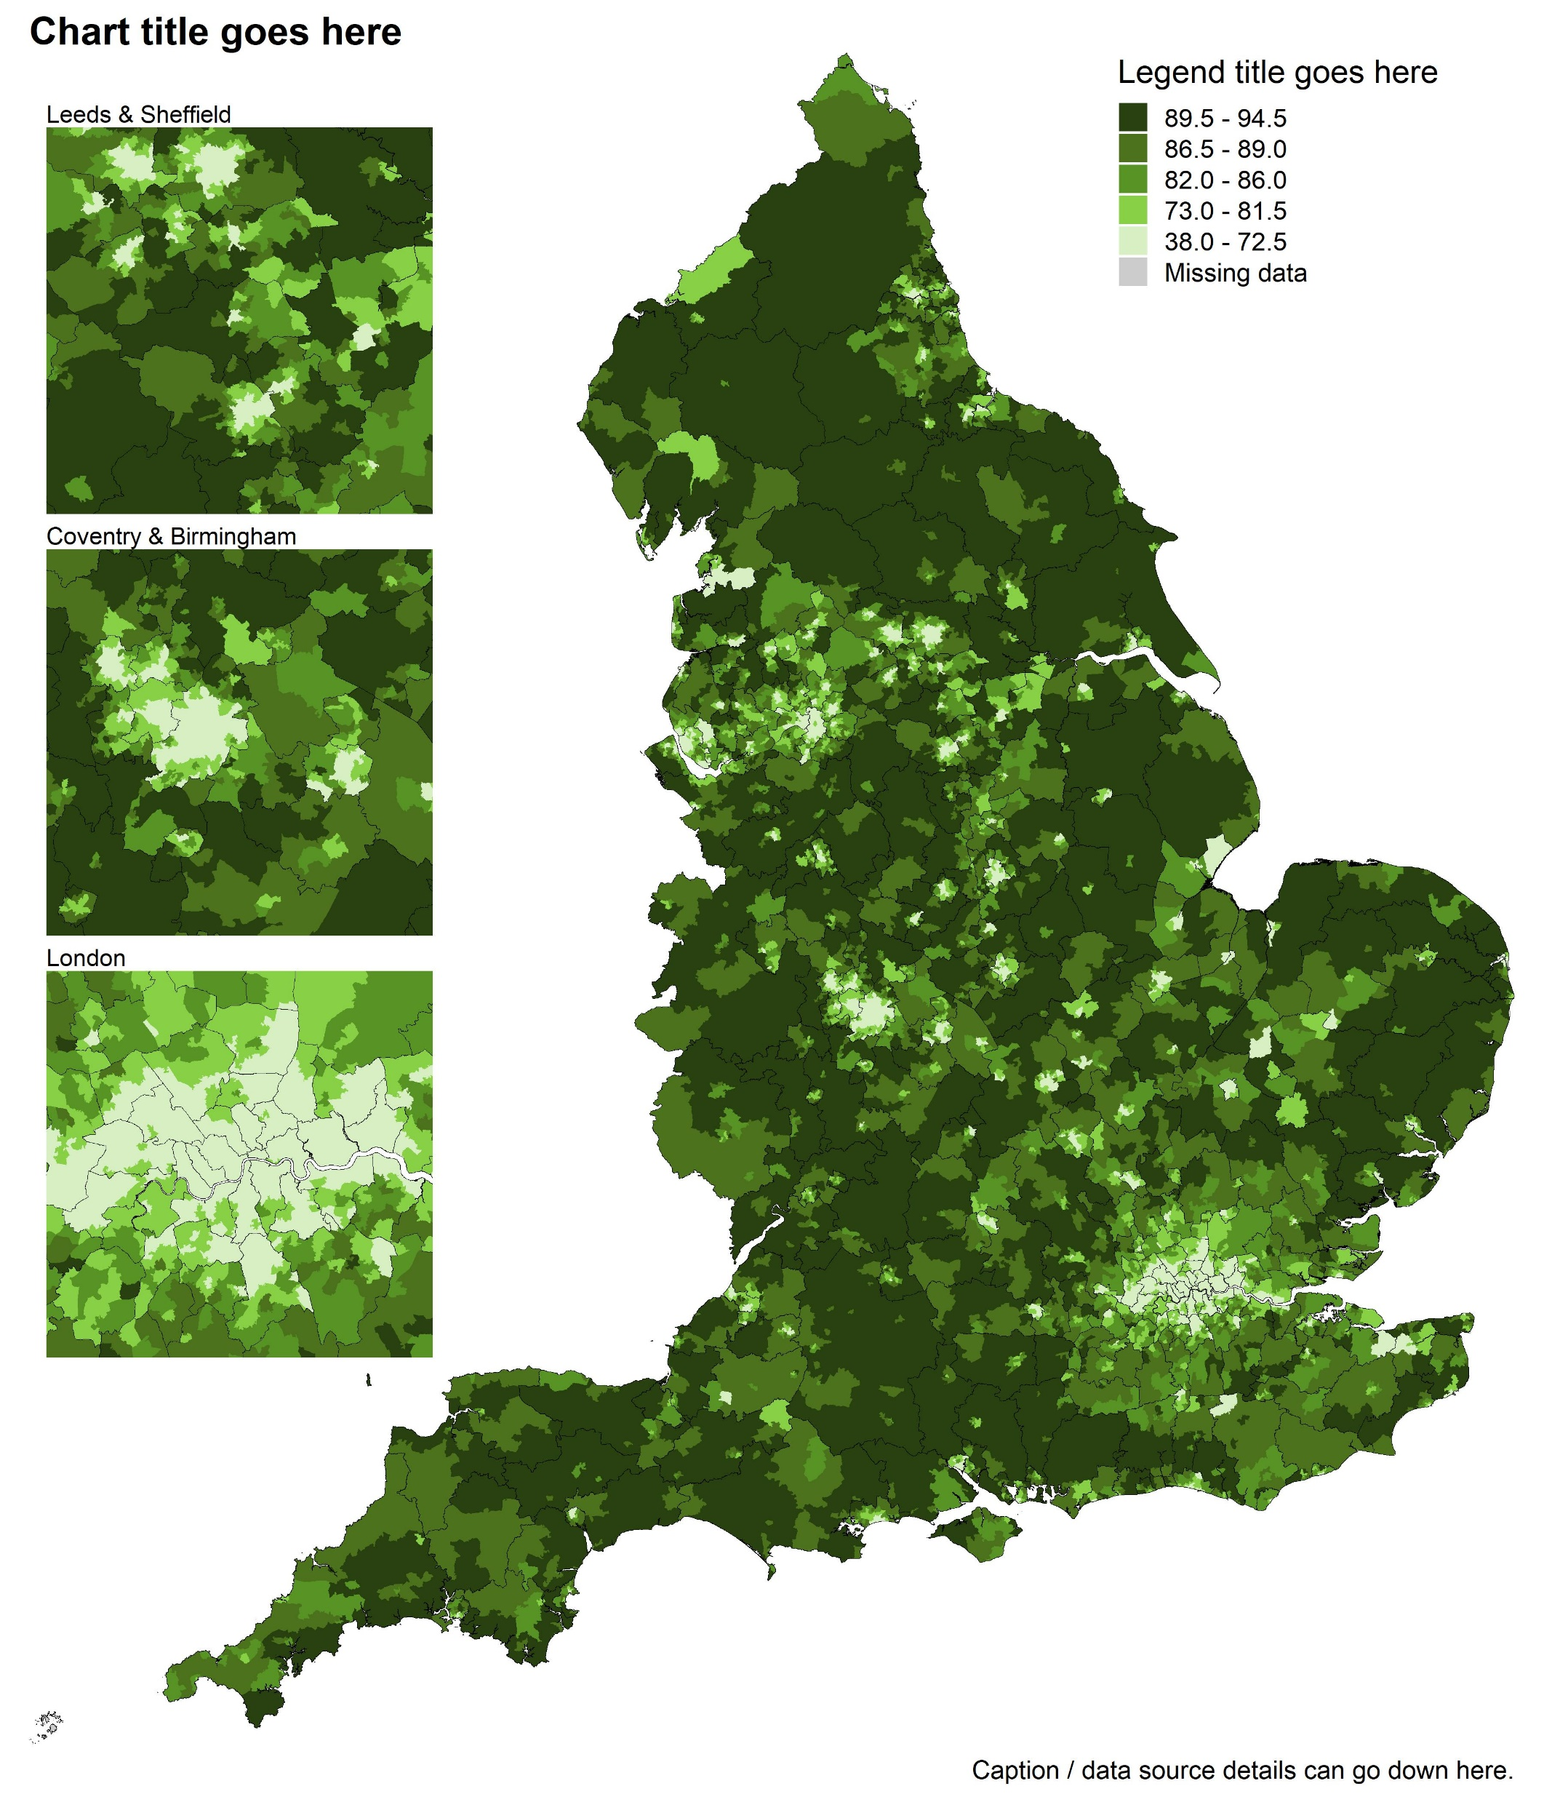
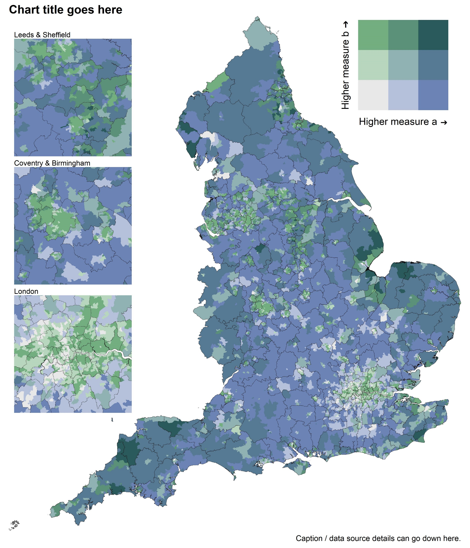
Choropleth maps with zoomed areas (optional)
Slide 4
Notes:
Image: https://rfortherestofus.com/wp-content/uploads/2019/07/grammar-of-graphics.png

Slide 5
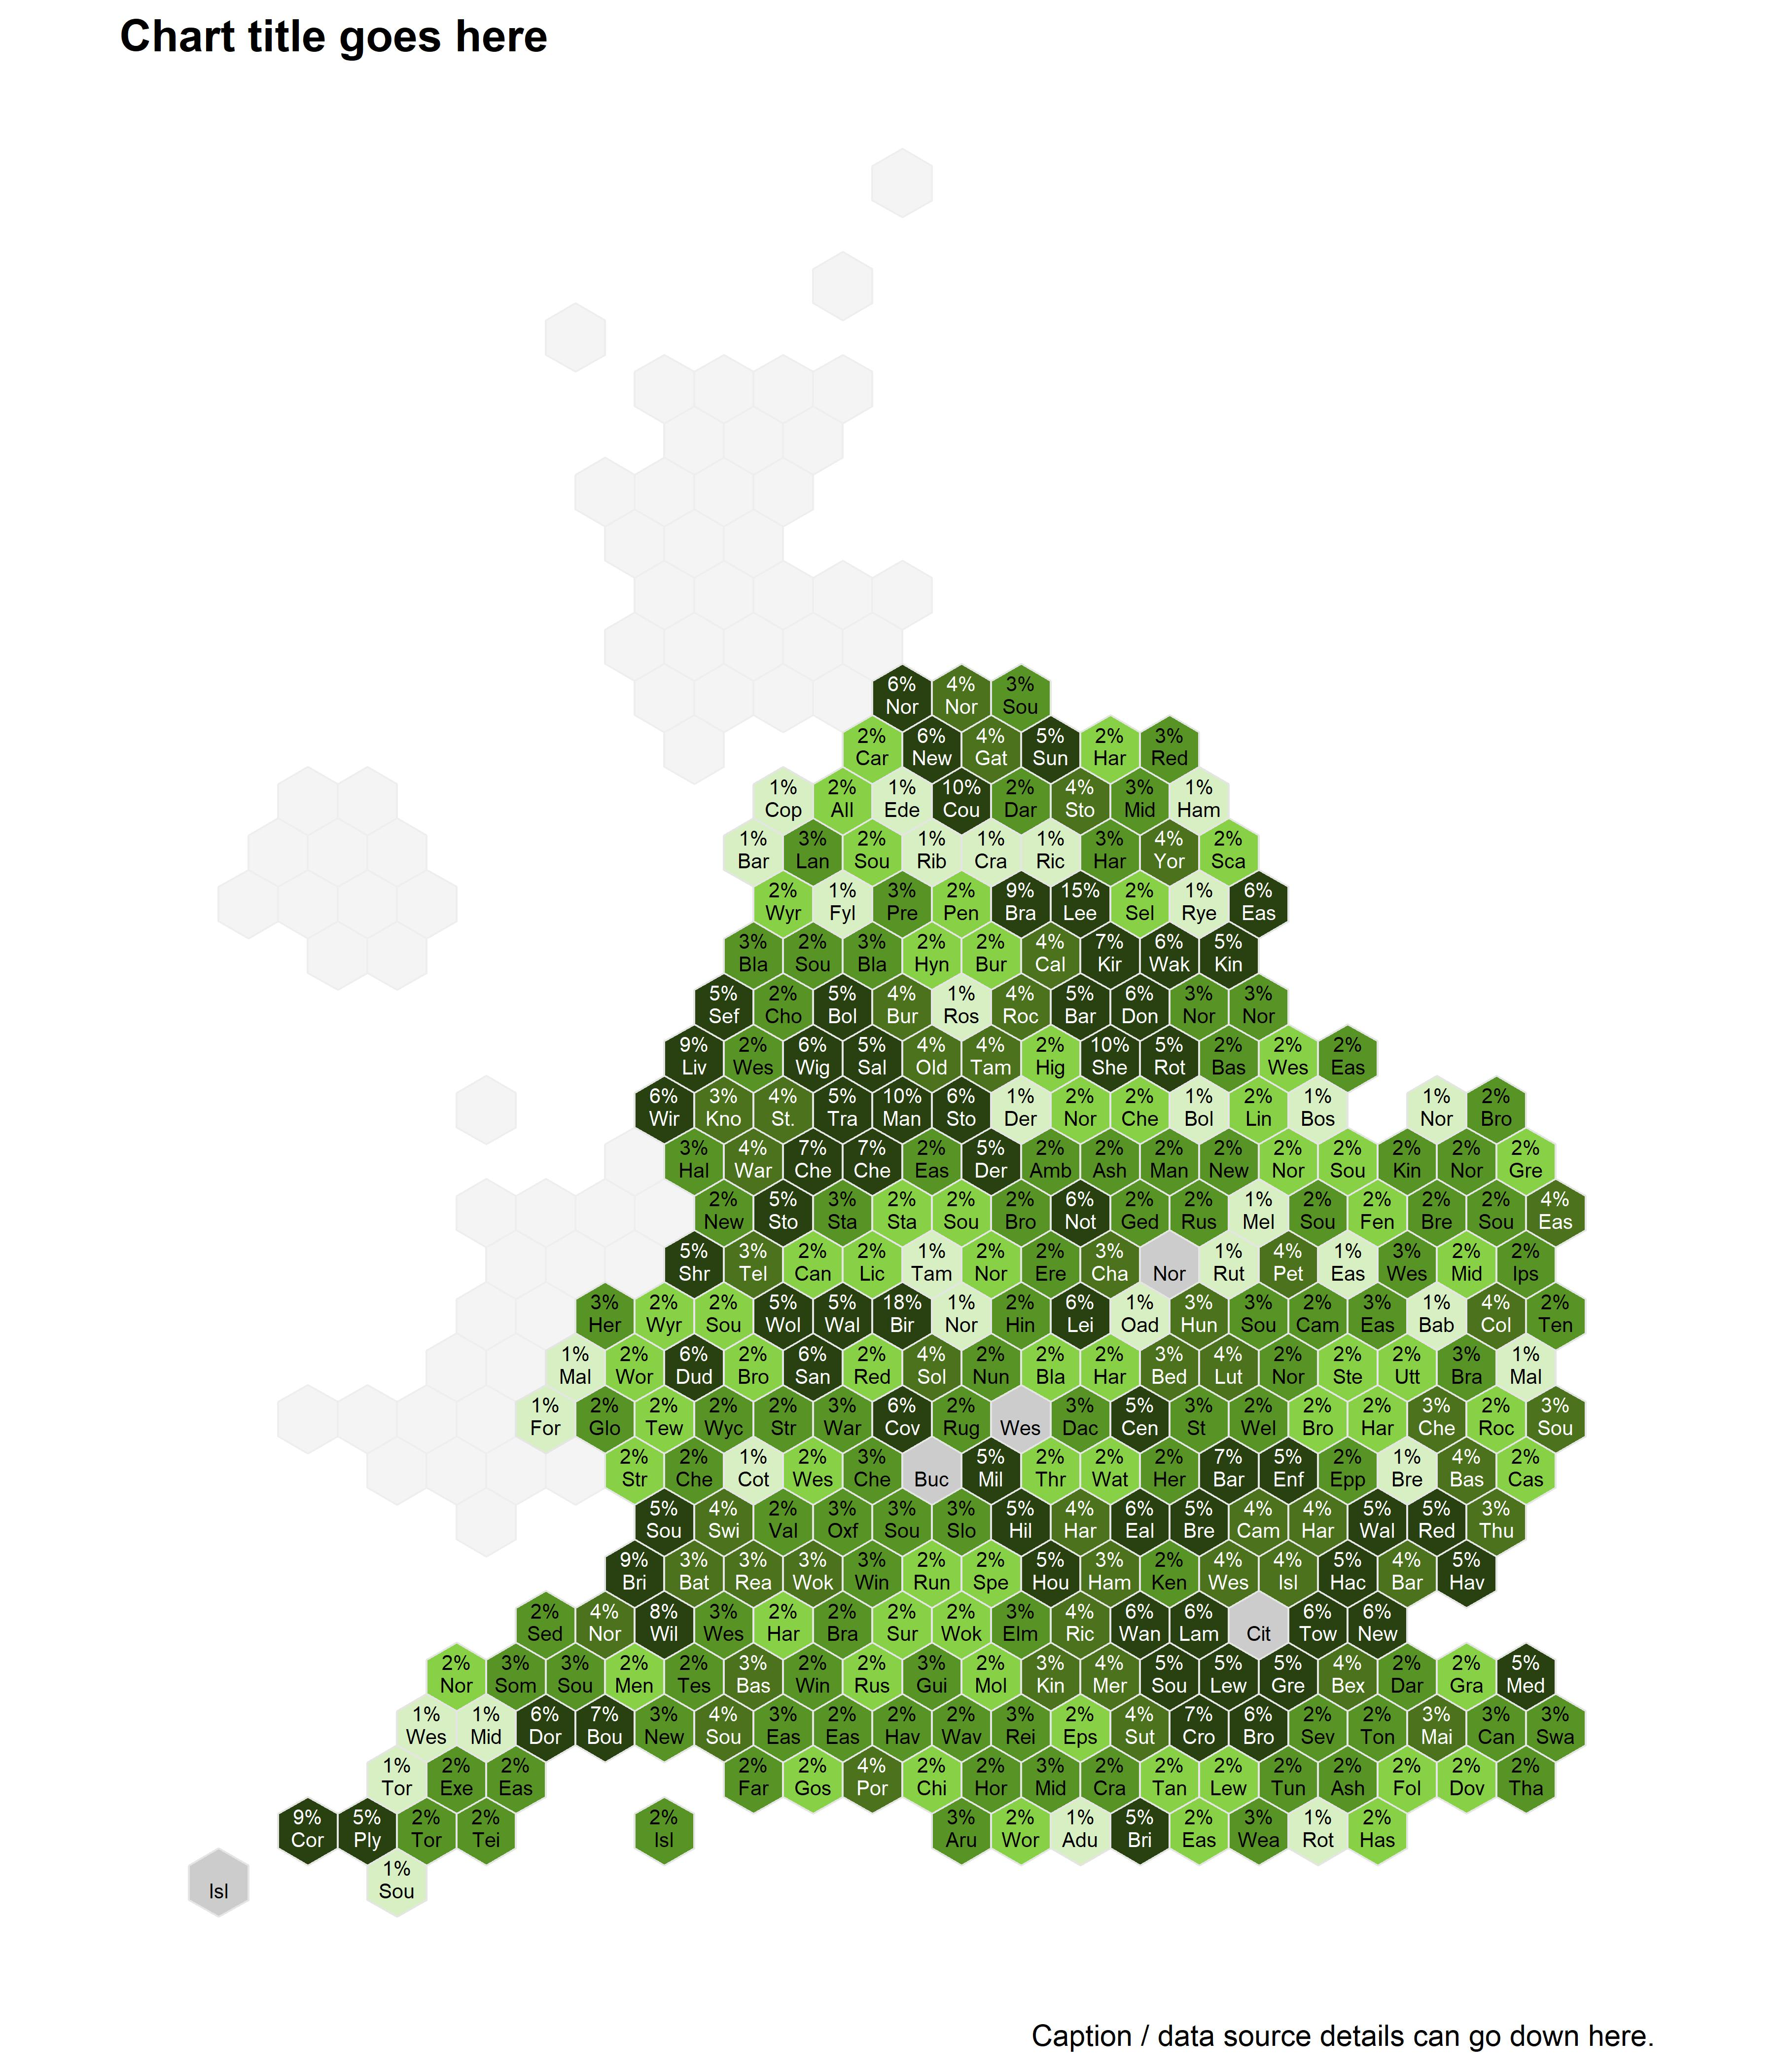
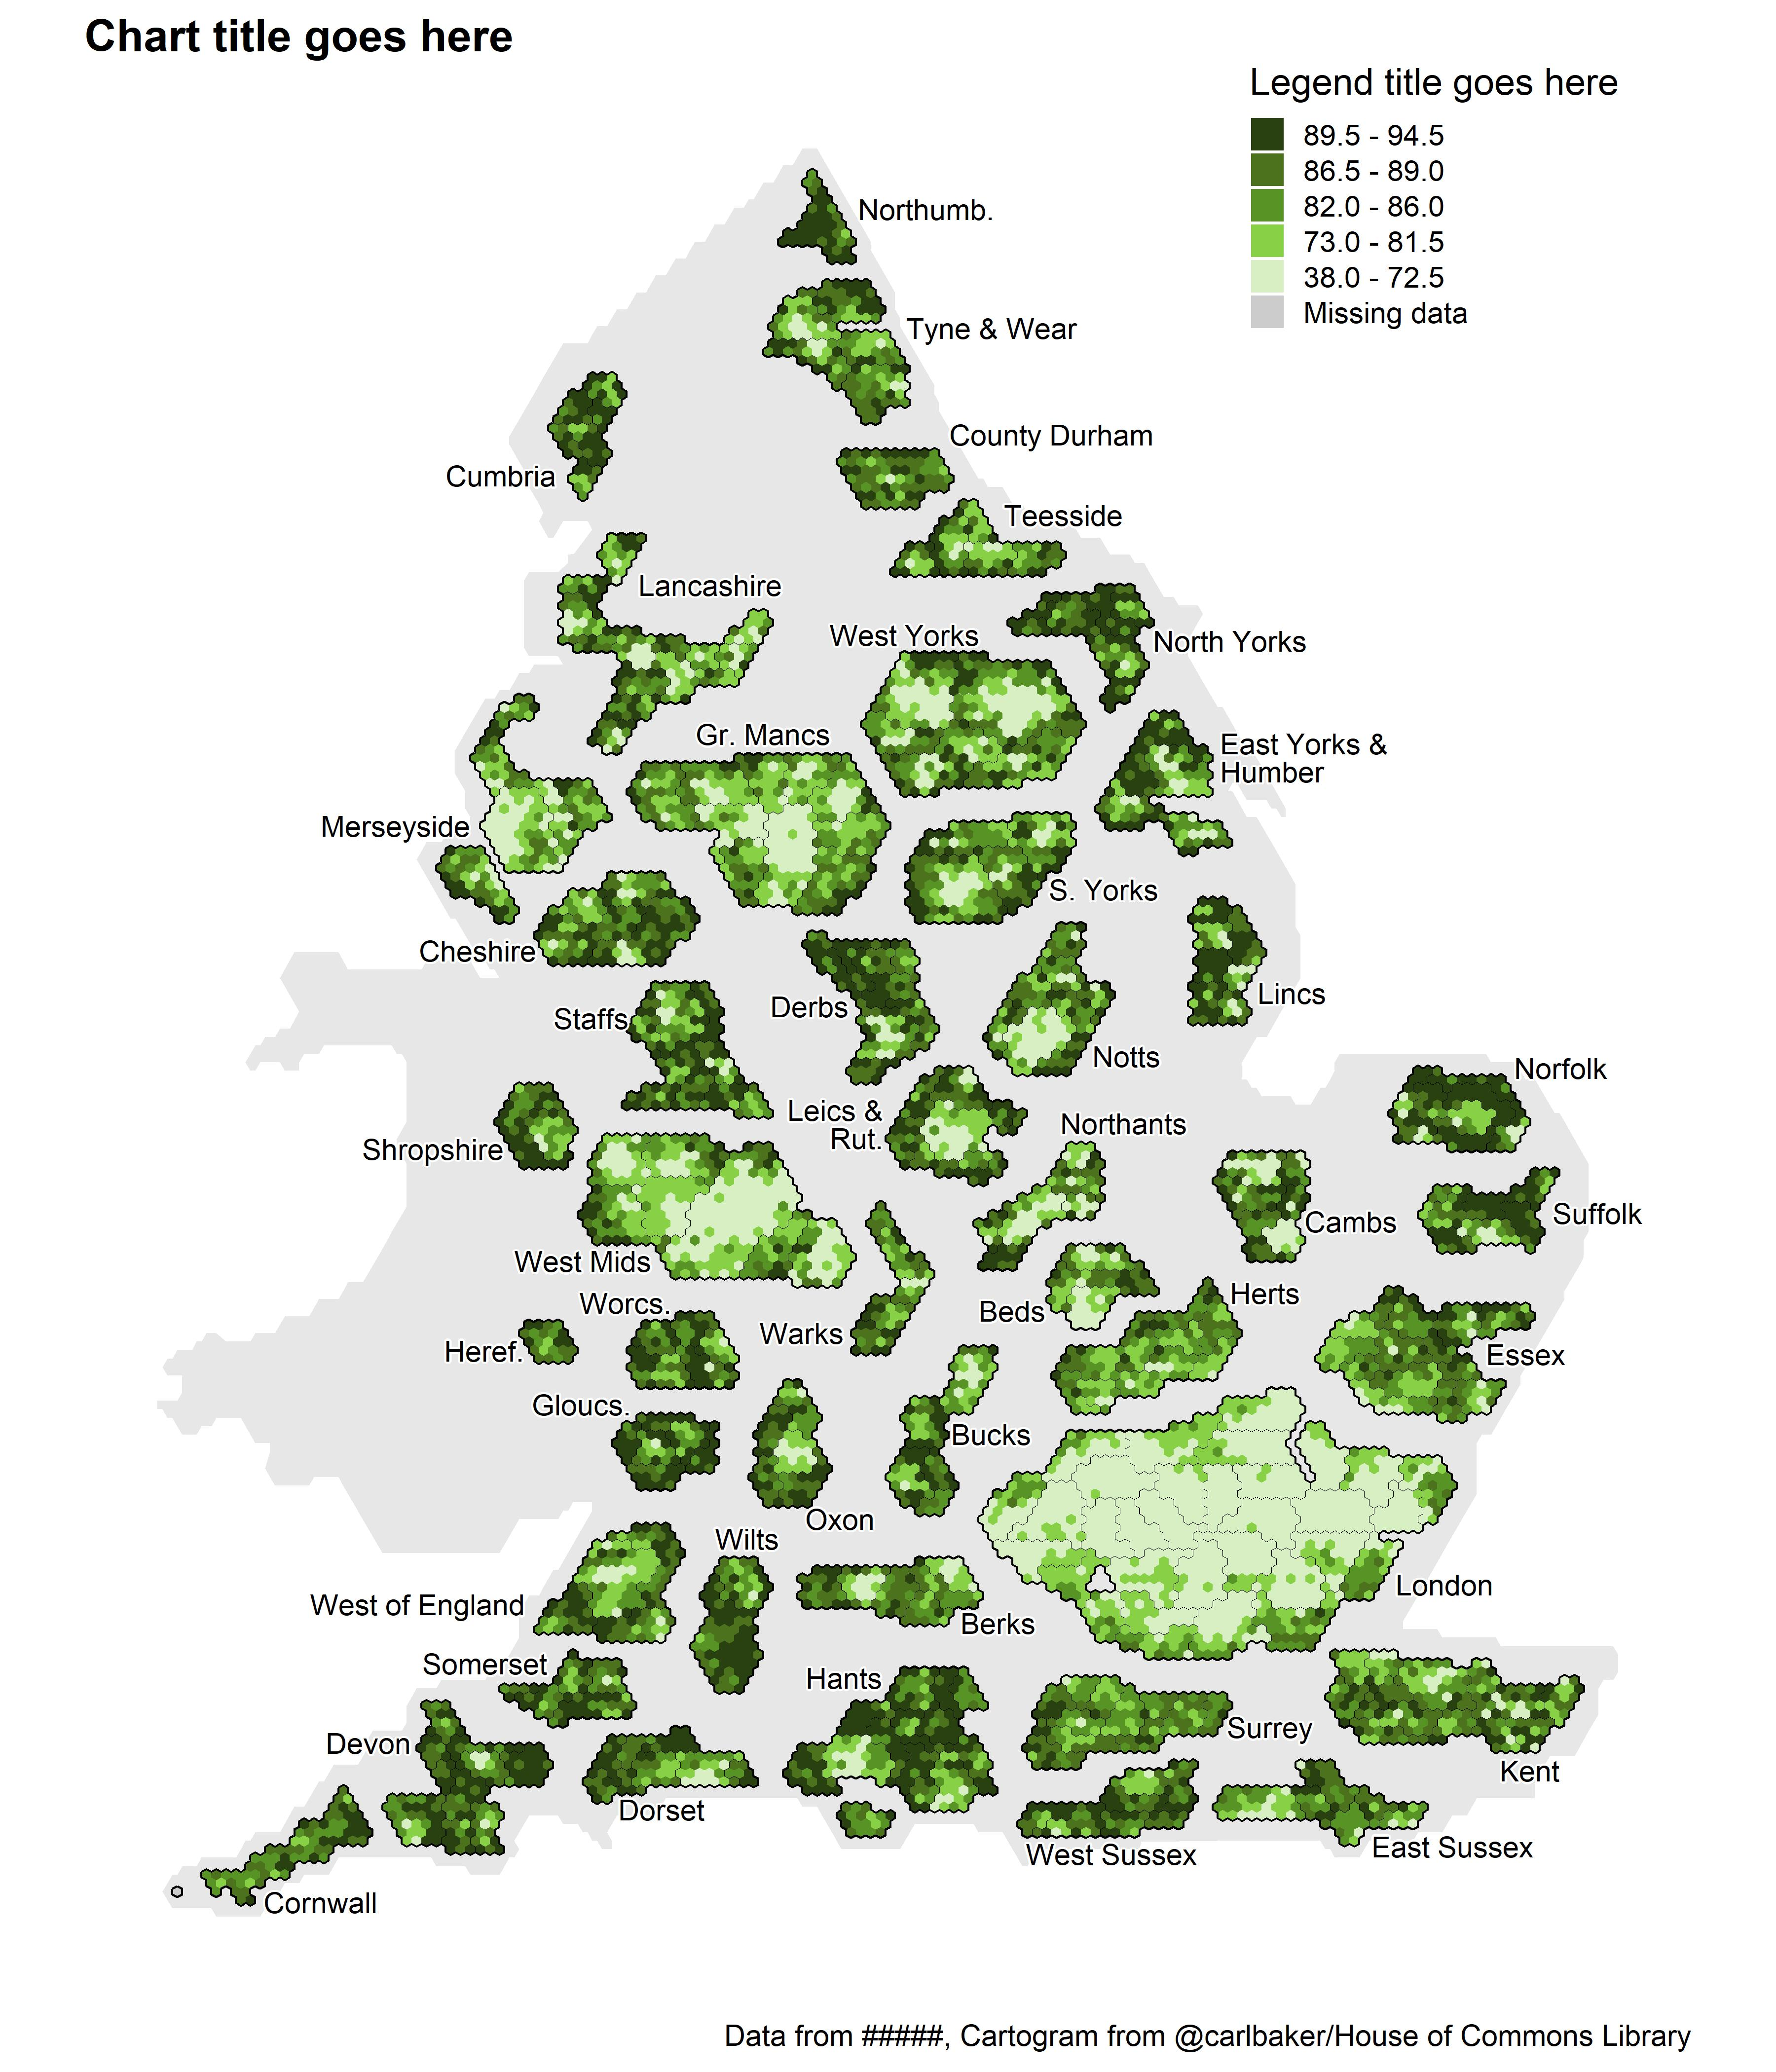
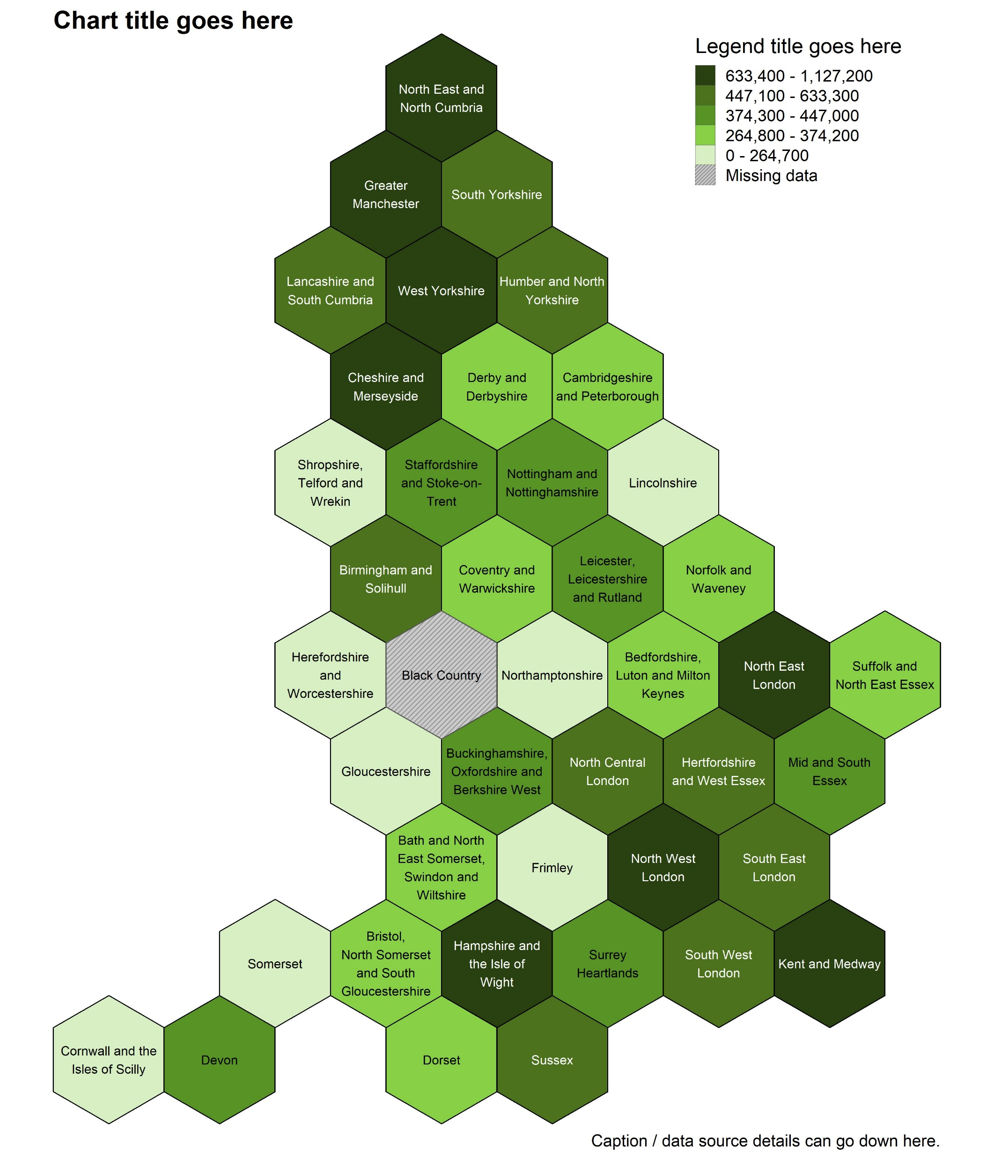
Hexagon-based cartograms
Slide 5
Notes:
Image: https://rfortherestofus.com/wp-content/uploads/2019/07/grammar-of-graphics.png

Slide 6
Example: Hexagon-based cartogram of LADs in England
We can use the template already written on the repo to make a plot.

Slide 7
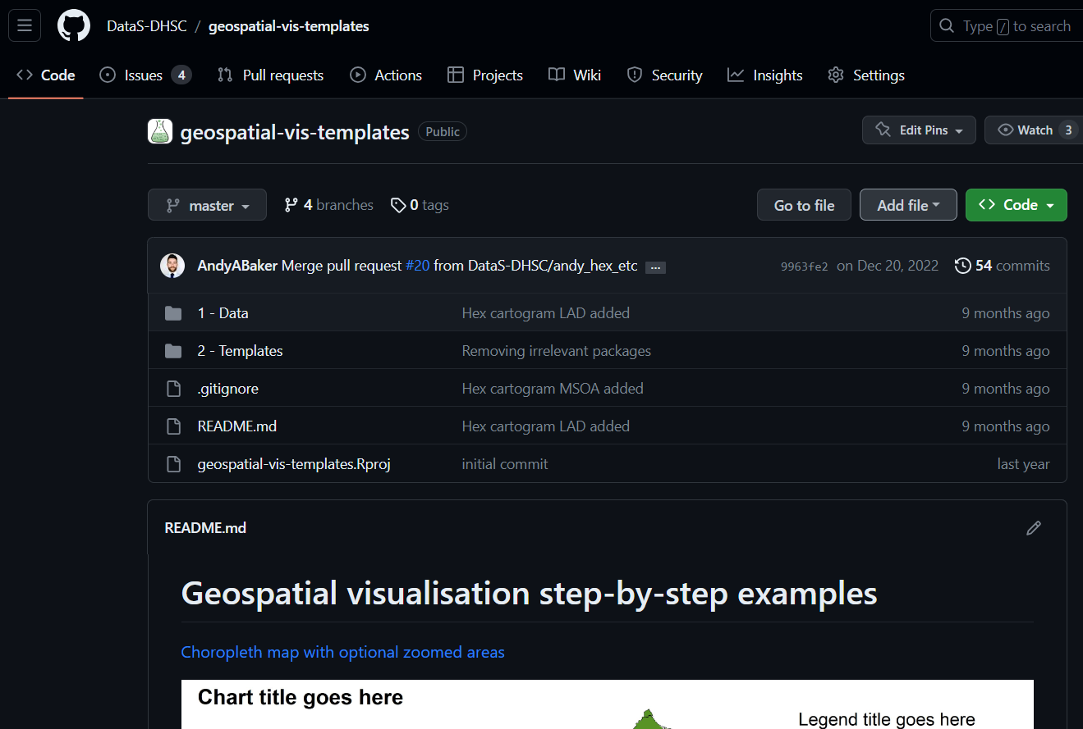

Slide 8
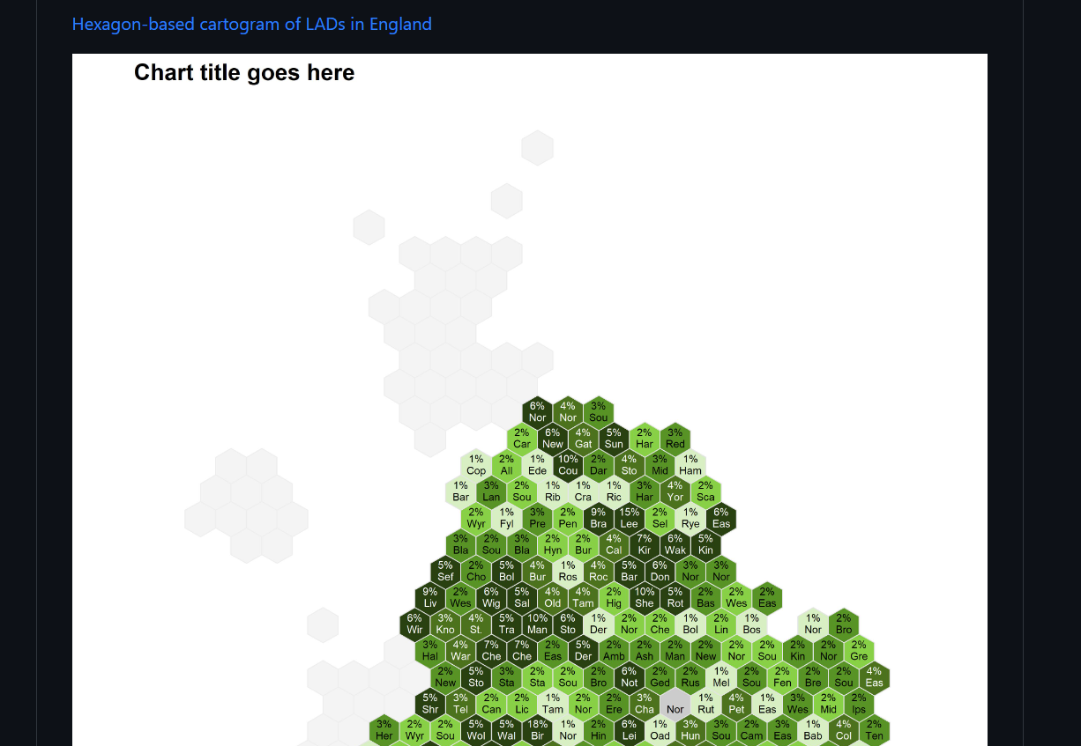

Slide 9
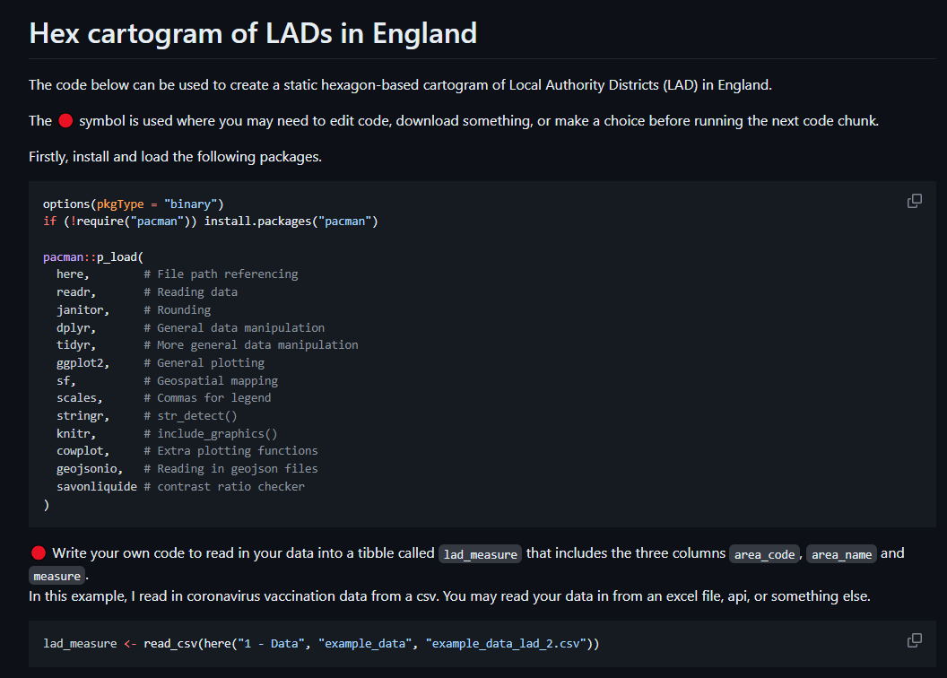

Slide 10
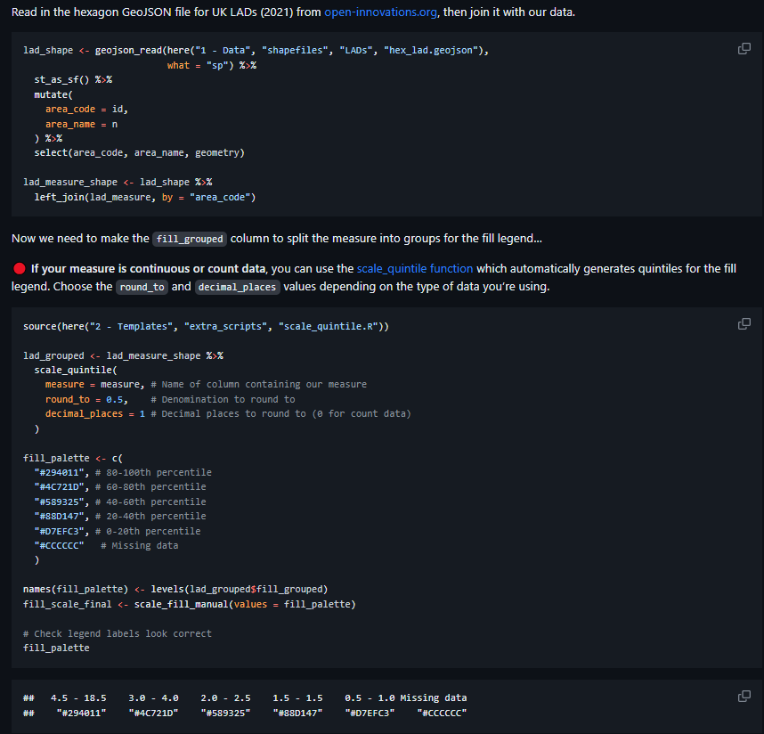

Slide 11
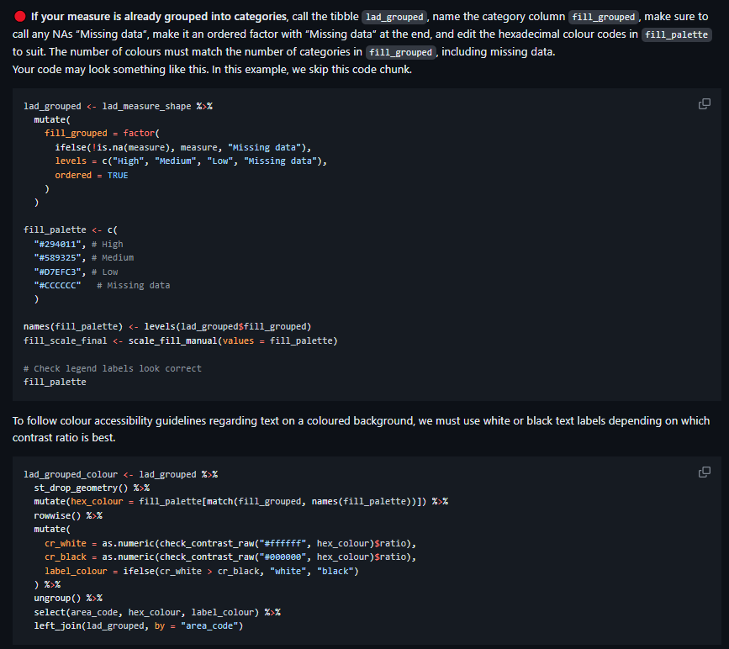

Slide 12
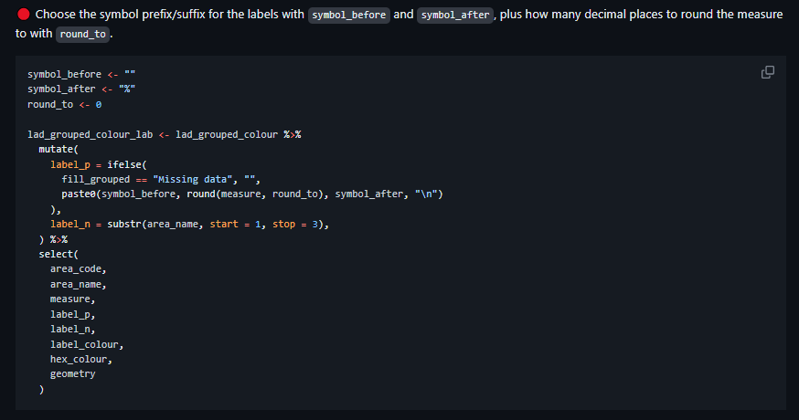

Slide 13
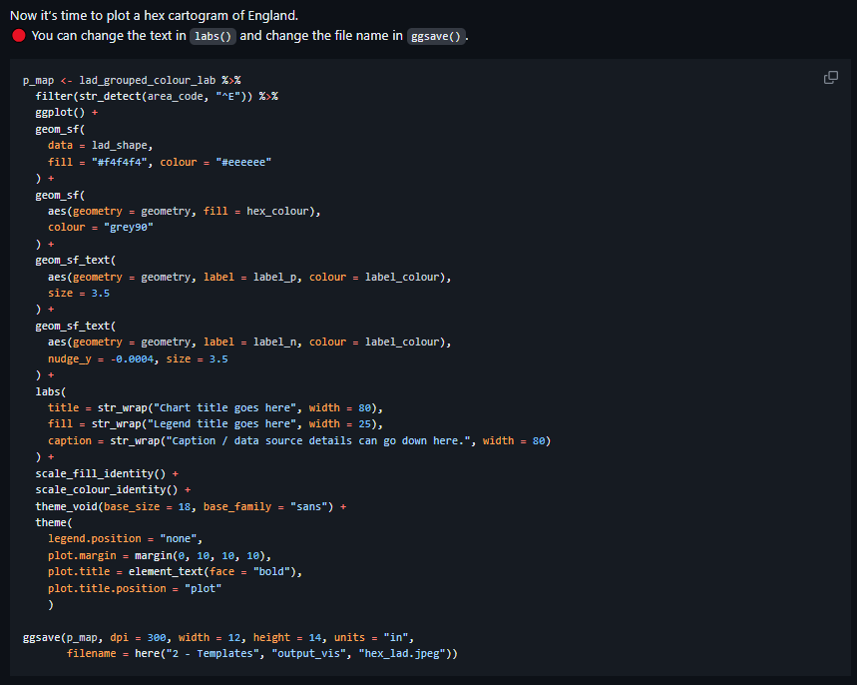

Slide 14
LADs in London are now much easier to see

Slide 15
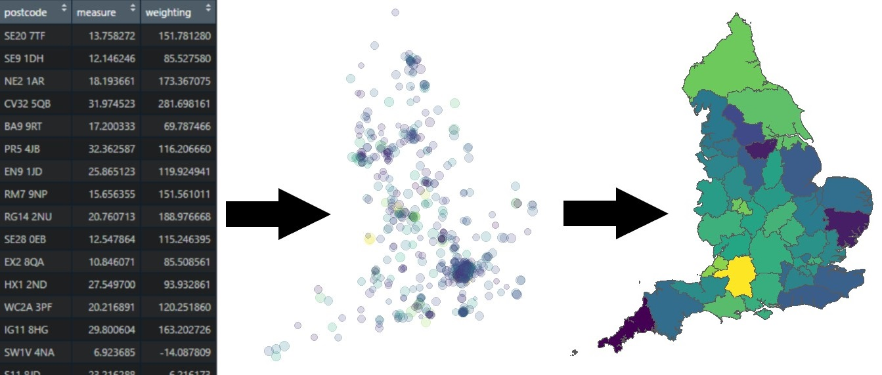
Helpful tools: Converting postcodes to points and areas
This template can convert any data from postcode level, to latitude and longitude, and finally to geographic areas.

Slide 16
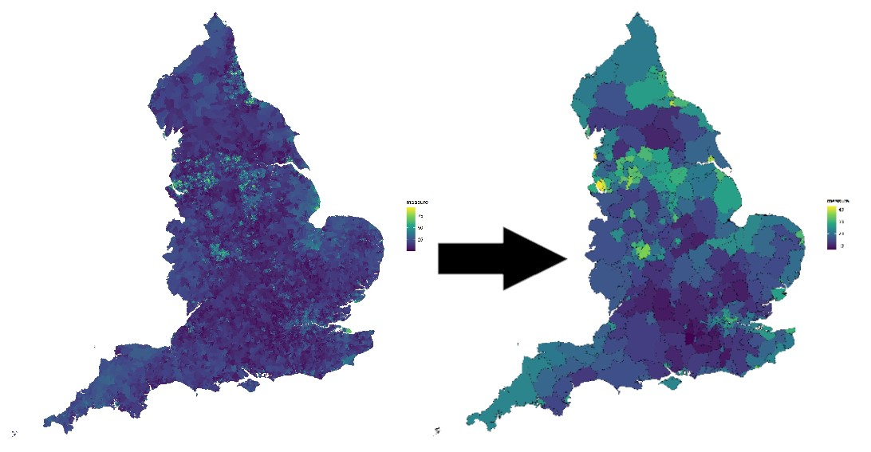
Helpful tools: Converting from one area to another
This template can convert any measure (e.g. IMD score) from any area (e.g. LSOA) to any other area (LAD).

Slide 17
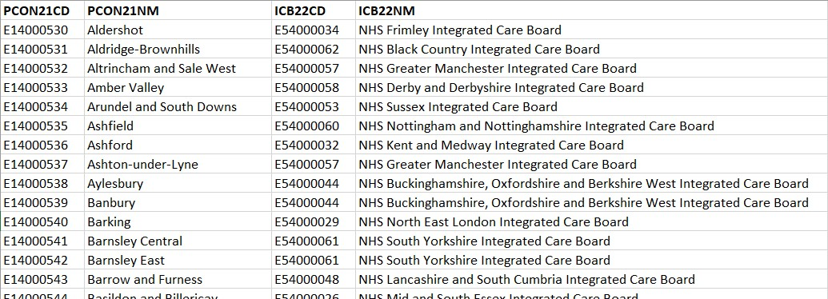
Helpful tools: Creating a lookup table between two geographies
This template can match up one set of areas (E.g. WPC) with another (E.g. ICB) to create a simple lookup file. This is calculated by seeing in which areas the 2nd area’s centroid points lie.

Slide 18
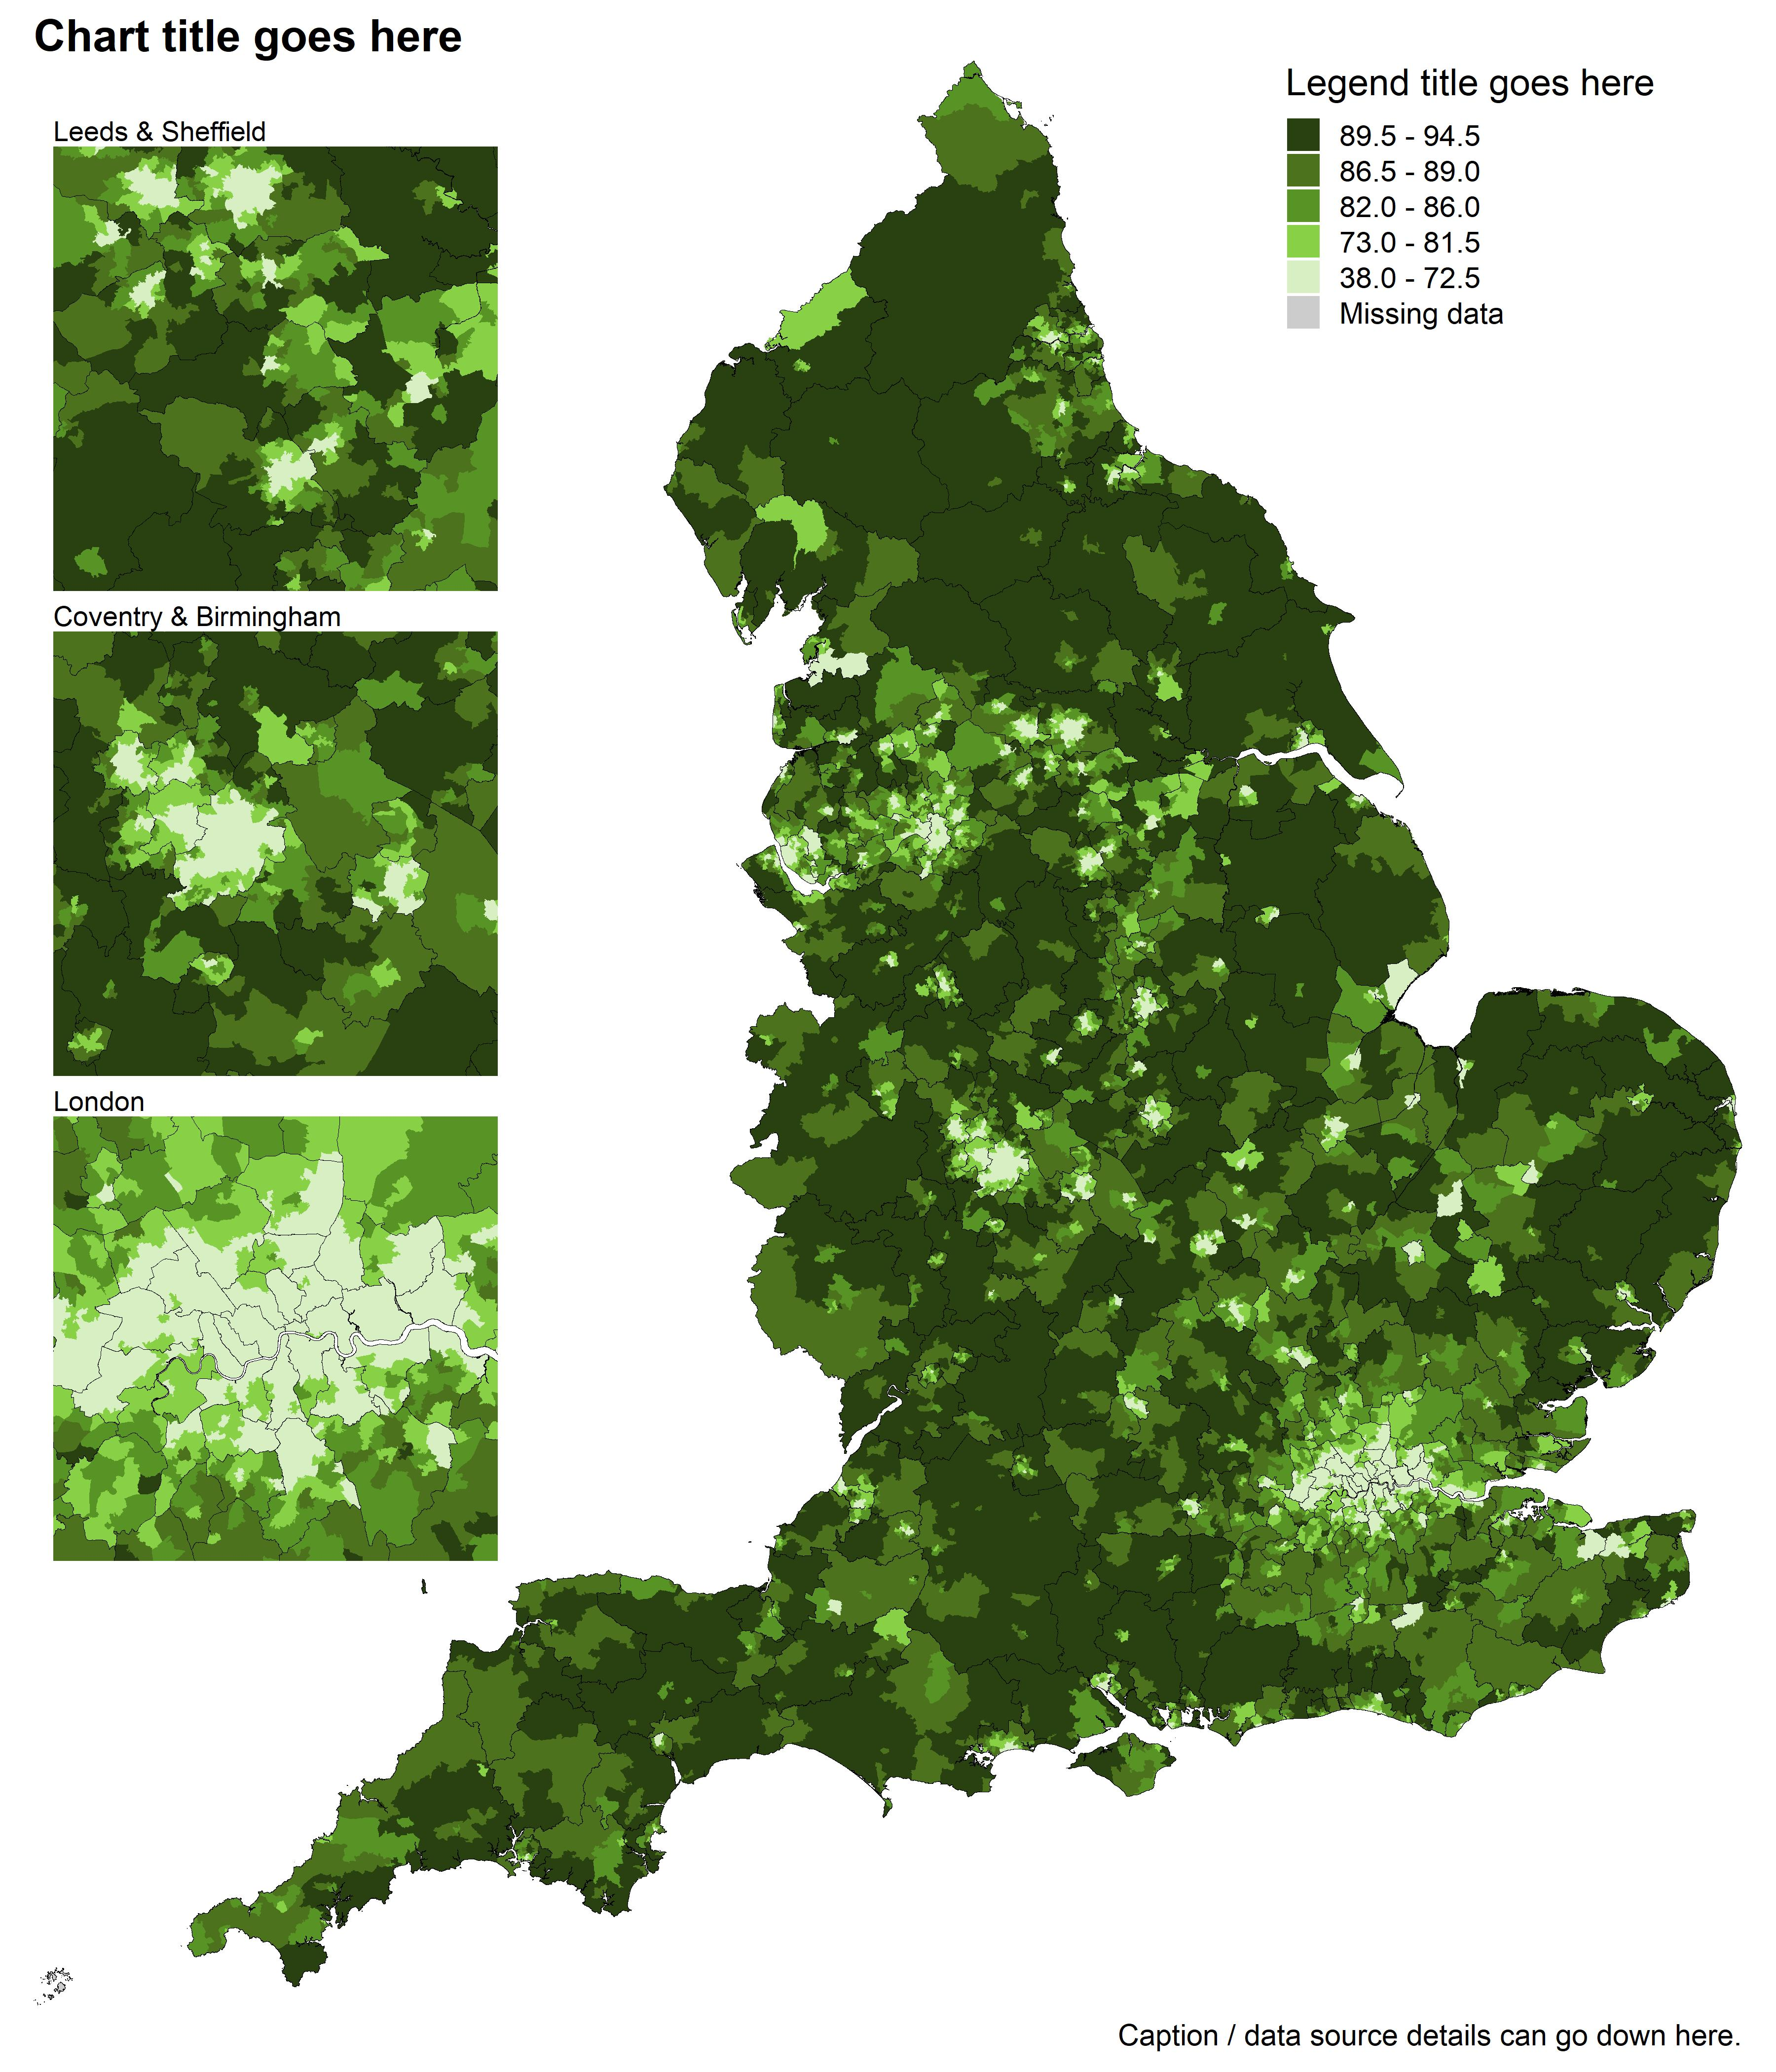
Helpful tools: Automatic quintile legend
It is good practice to use a limited number of colours, or ideally shades of one colour, instead of a continuous gradient for choropleth maps.
In many example templates, I use a function called scale_quintile(). This function splits your measure into five equally sized groups, rounds each value up to the nearest round_to, whilst keeping the numbers at a specified number of decimal_places.
Examples:
scale_quintile(df, case_count, round_to = 100, decimal_places = 0)
"89,200 - 368,200"
"55,700 - 89,100"
"43,100 - 55,600"
"33,600 - 43,000"
"6,200 - 33,500"
scale_quintile(df, estimate, round_to = 0.005, decimal_places = 3)
"0.055 - 0.075"
"0.045 - 0.050"
"0.035 - 0.040"
"0.020 - 0.030"
"0.005 - 0.015"

Slide 19
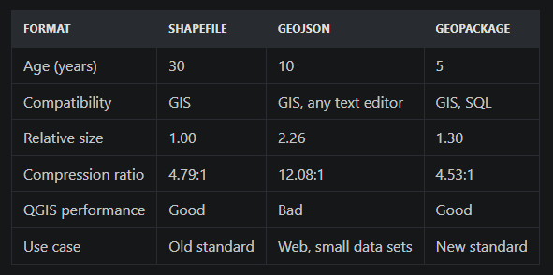
Other useful info: Which is best? Shapefile or GeoJSON or Geopackage?
Shapefiles:
A bit awkward to store (you need the shp file along with the cpg, dbf, prj, shx, and xml files).
Pretty small file size
GeoJSON
Just one file
File size way bigger than shapefiles
Geopackage
File size a bit bigger than shapefiles
Apparently an official replacement for shapefiles
Shapefile vs. GeoJSON vs. GeoPackage (terramonitor.com)

Slide 20
Other useful info: mapshaper.org
Boundary file too big? Everything running slowly?
https://mapshaper.org/

Slide 21
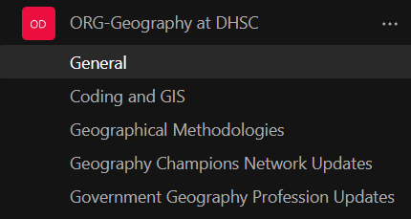
Other useful info: Teams channel
Please join the ORG-Geography at DHSC teams channel!

